Slide 1
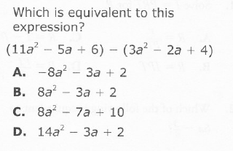
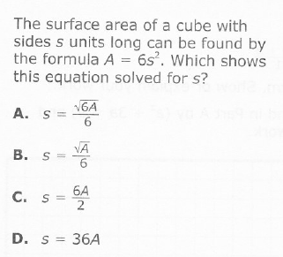
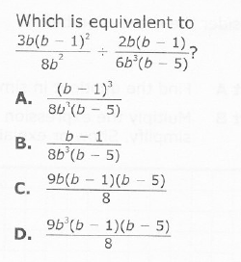
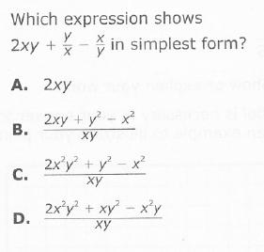
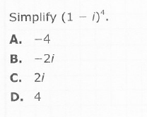
Pre-test #1
1.
2.
3.
4.
5.
6.

Slide 2
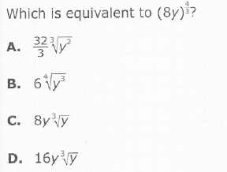
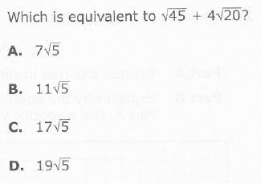
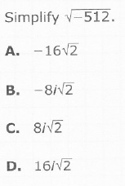
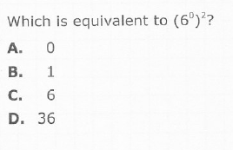
7.
8.
9.
10.

Slide 3
8,9 Expressions and Operations with Radicals

Slide 4
8,9 Expressions and Operations with Radicals

Slide 5
8,9 Expressions and Operations with Radicals

Slide 6
8,9 Expressions and Operations with Radicals

Slide 7
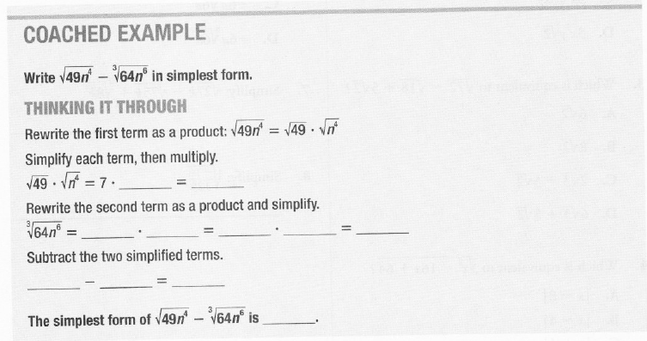
8,9 Expressions and Operations with Radicals
You try!

Slide 8
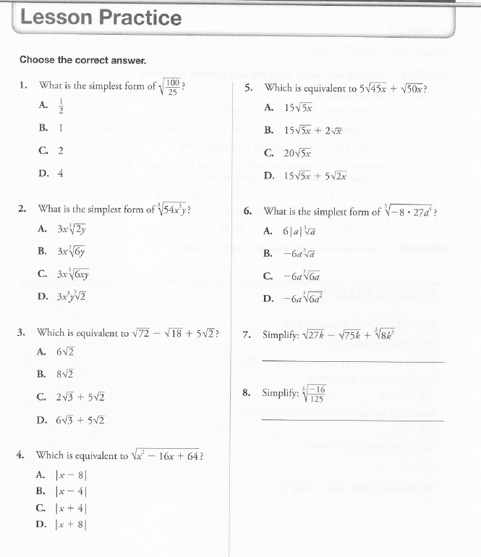
8,9

Slide 9
1. Converting between Radical and Exponential Forms of Expressions

Slide 10
1,7 Converting between Radical and Exponential Forms of Expressions

Slide 11
1,7 Converting between Radical and Exponential Forms of Expressions

Slide 12
1,7 Converting between Radical and Exponential Forms of Expressions
You try!

Slide 13
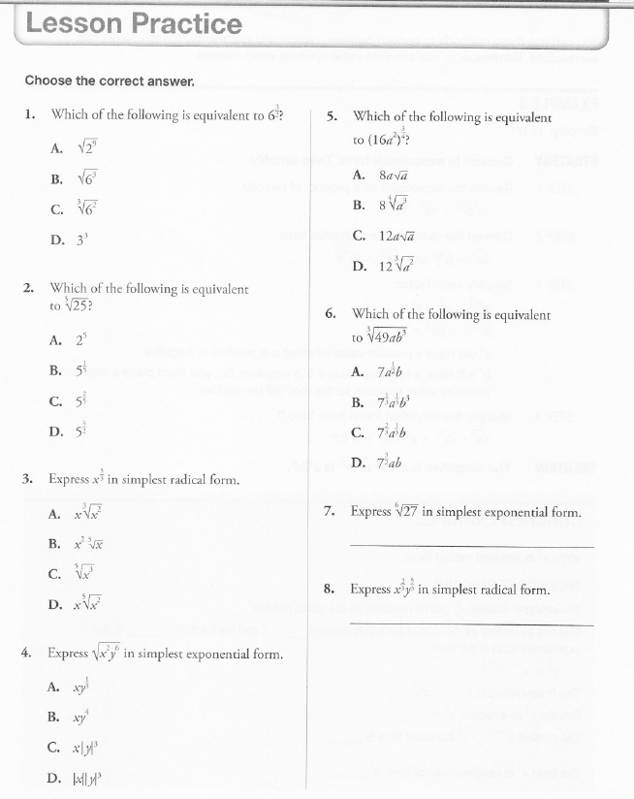
1,7

Slide 14
10.Applying the Laws of Exponents

Slide 15
10. Applying the Laws of Exponents

Slide 16
10. Applying the Laws of Exponents

Slide 17
10. Applying the Laws of Exponents

Slide 18
10. Applying the Laws of Exponents
You try!

Slide 19
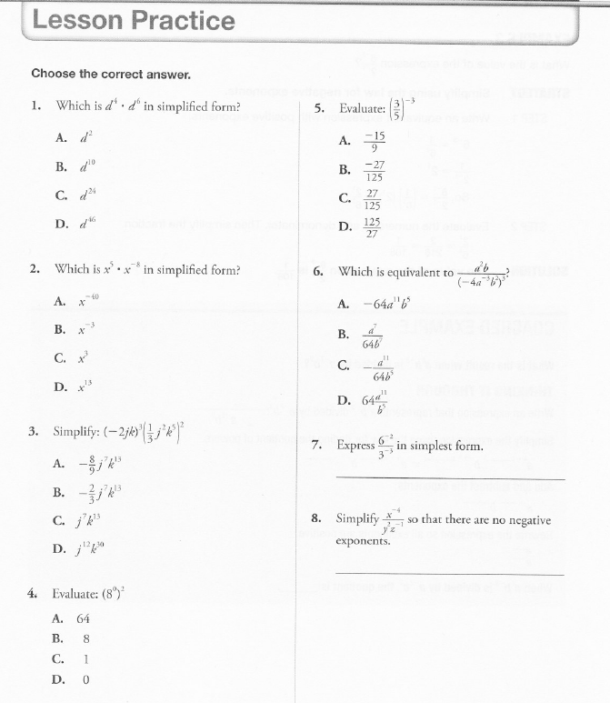
10.

Slide 20
6. Complex Numbers

Slide 21
6. Complex Numbers

Slide 22
6. Complex Numbers

Slide 23
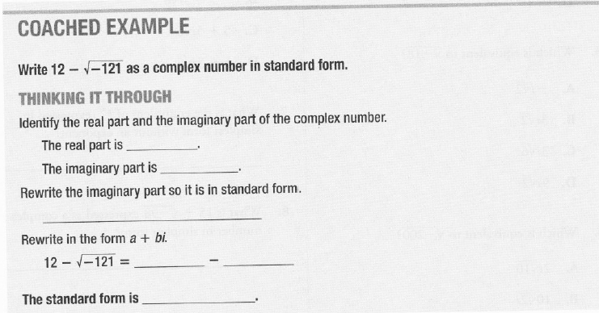
6. Complex Numbers
You try!

Slide 24
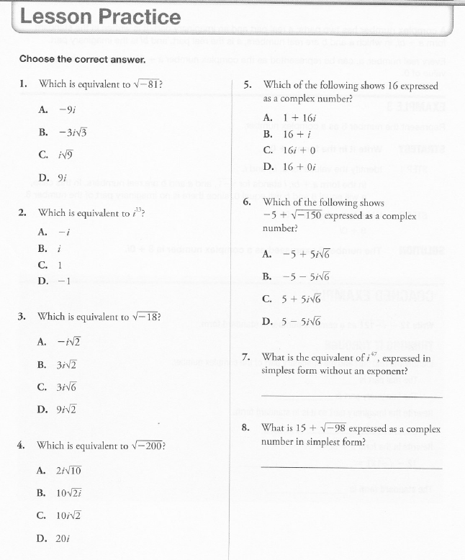
6.

Slide 25
Operations on the Set of Complex Numbers

Slide 26
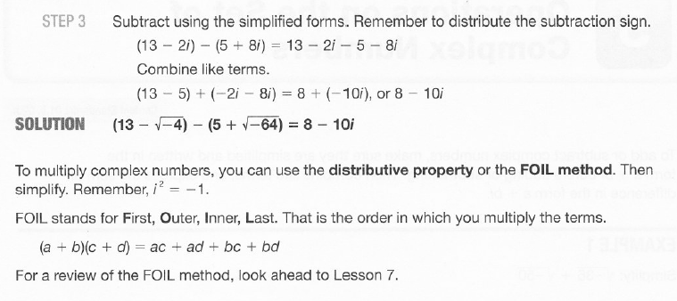
Operations on the Set of Complex Numbers

Slide 27
Operations on the Set of Complex Numbers

Slide 28
Operations on the Set of Complex Numbers

Slide 29
Operations on the Set of Complex Numbers
You try!

Slide 30
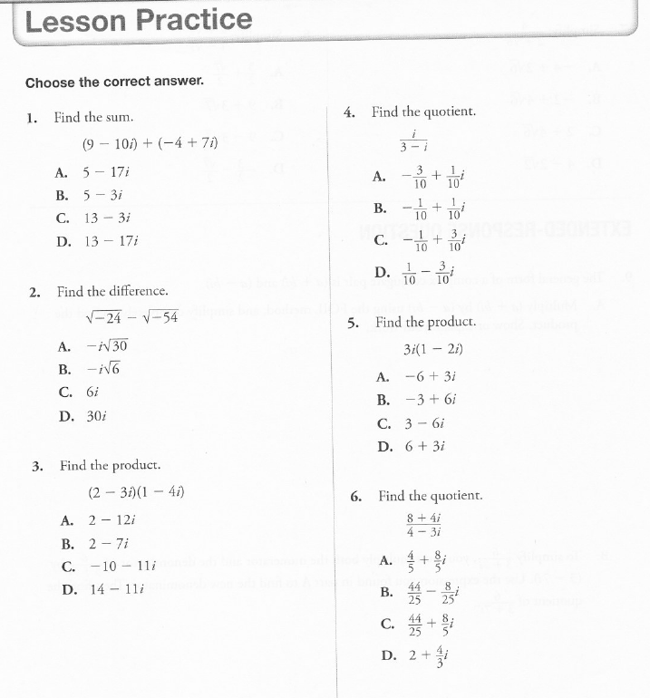

Slide 31
2. Adding and Subtracting Polynomial Expressions

Slide 32
2. Adding and Subtracting Polynomial Expressions

Slide 33
2. Adding and Subtracting Polynomial Expressions
You try!

Slide 34
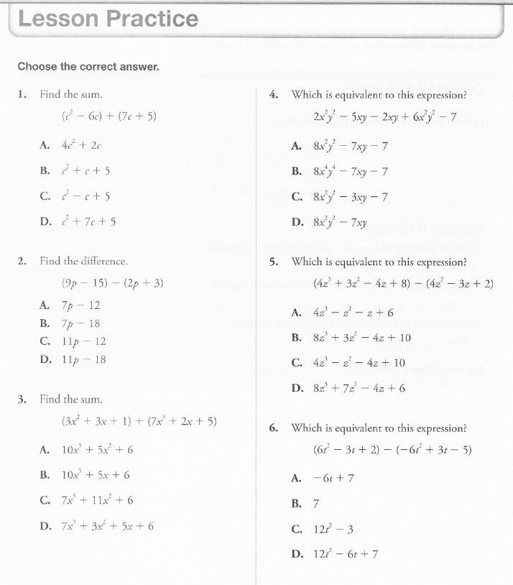
2.

Slide 35
Multiply and Dividing Polynomial Expressions

Slide 36
Multiply and Dividing Polynomial Expressions

Slide 37
Multiply and Dividing Polynomial Expressions

Slide 38
Multiply and Dividing Polynomial Expressions

Slide 39
Multiply and Dividing Polynomial Expressions
You try!

Slide 40
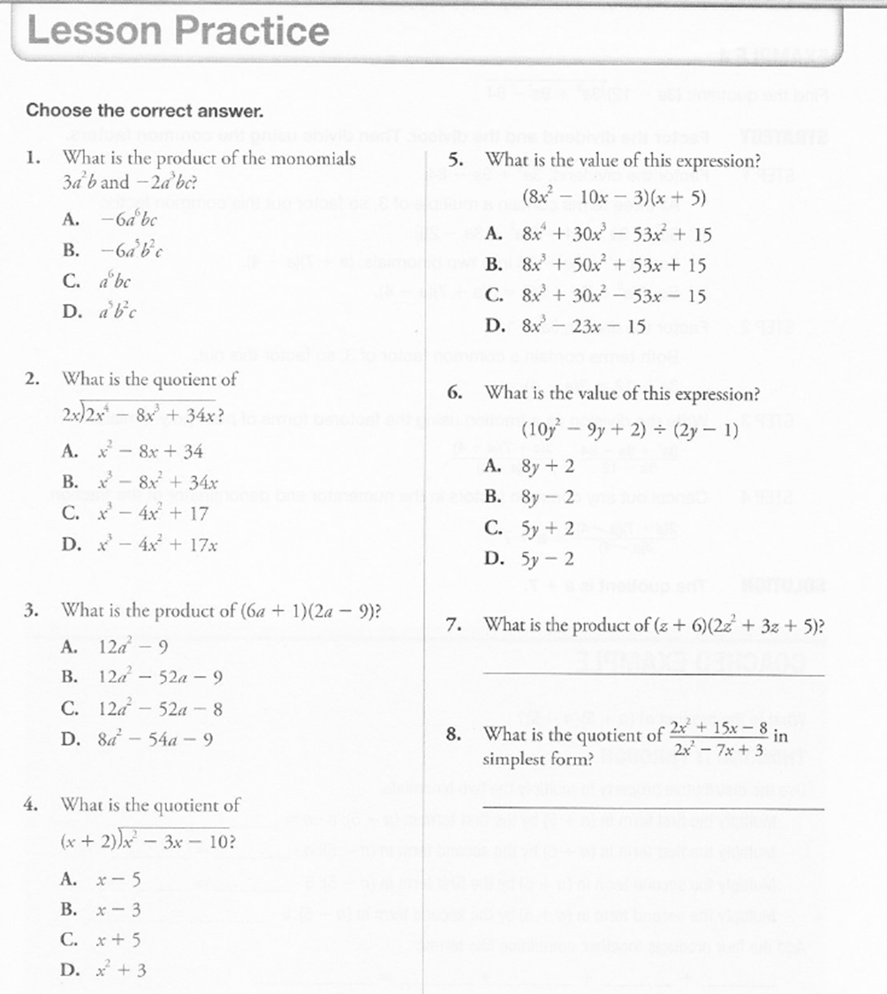

Slide 41
4,5 Operations on Rational Expressions

Slide 42
4,5 Operations on Rational Expressions

Slide 43
4,5 Operations on Rational Expressions

Slide 44
4,5 Operations on Rational Expressions

Slide 45
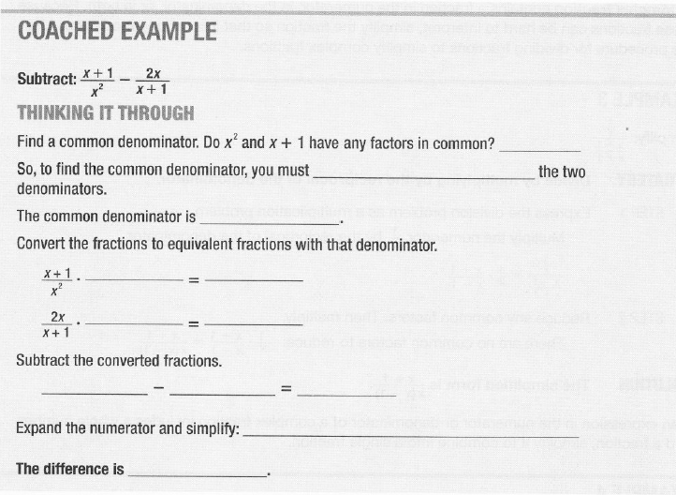
4,5 Operations on Rational Expressions
You try!

Slide 46
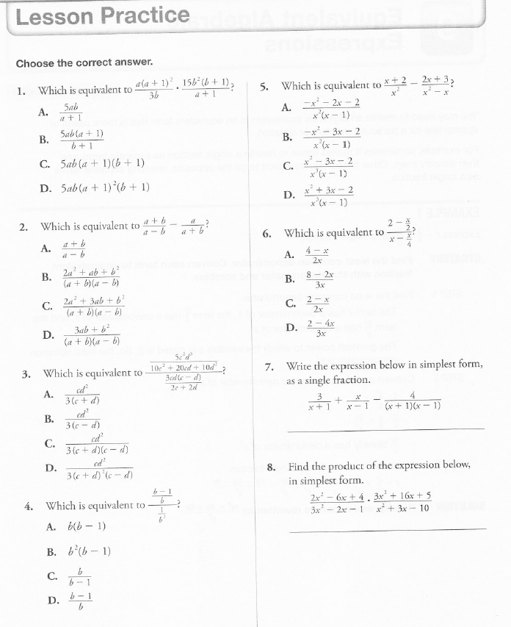
4,5

Slide 47
3. Equivalent Algebraic Expressions

Slide 48
3. Equivalent Algebraic Expressions

Slide 49
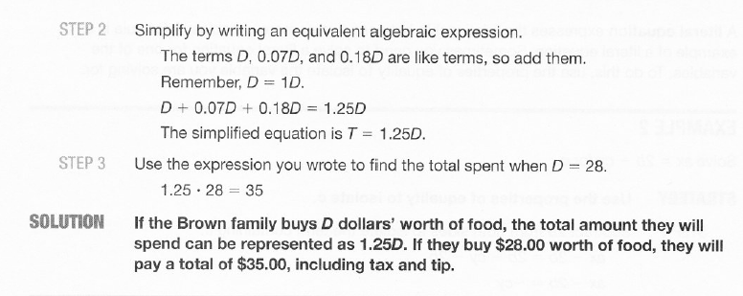
3. Equivalent Algebraic Expressions

Slide 50
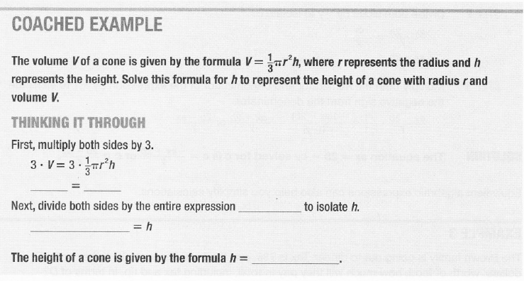
3. Equivalent Algebraic Expressions
You try!

Slide 51
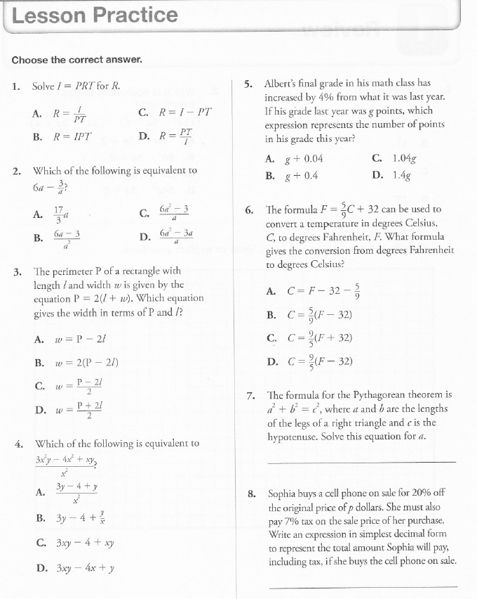
3.

